Slide 1

Enhancements of JAVA 7 & 8
Dec 20, 2016
Shareef – Crew Pay

Slide 2
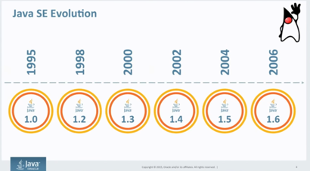

Slide 3
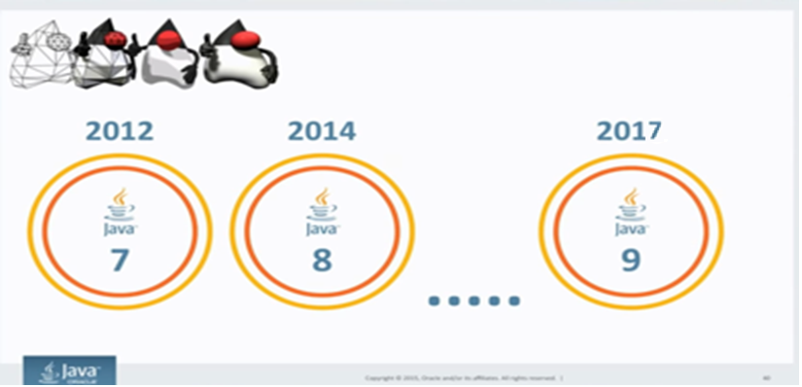

Slide 4

Agenda
Java 7 features
http://openjdk.java.net/projects/jdk7/features
Language features
Strings in switch statements
try-with-resources statements
improved exception handling (multi-catch)
improved type inference for generic instance creation ("diamond")
Underscores in Numeric literals
Bynary literals, and simplified varargs method invocation
I/O enhancements
java.nio.file API
java.nio.file.attribute API
java.nio.file.spi API

Slide 5


http://openjdk.java.net/projects/jdk7/features

Slide 6
Strings in switch Statements
In Java SE 7, and later, you can use a String object in the switch statement's expression. The following code example, displays the number of the month based on the value of the String named month:
switch (dayOfWeek) {
case "Monday": typeOfDay = "Start of work week"; break;
case "Tuesday":
case "Wednesday":
….
default: throw new IllegalArgumentException("Invalid day of the week: " + dayOfWeek);
}
The switch statement compares the String object in its expression with the expressions associated with each case label as if it were using the String.equals method; consequently, the comparison of String objects in switch statements is case sensitive. The Java compiler generates generally more efficient byte code from switch statements that use String objects than from chained if-then-else statements.

Slide 7
Try_with_Resource
The try-with-resources statement is a try statement that declares one or more resources. A resource is as an object that must be closed after the program is finished with it. The try-with-resources statement ensures that each resource is closed at the end of the statement. Any object that implements java.lang.AutoCloseable, which includes all objects which implement java.io.Closeable, can be used as a resource.
The following example reads the first line from a file. It uses an instance of BufferedReader to read data from the file. BufferedReader is a resource that must be closed after the program is finished with it:
static String readFirstLineFromFile(String path) throws IOException {
try (BufferedReader br = new BufferedReader(new FileReader(path))) {
return br.readLine();
}
}

Slide 8
Catching Multiple Exceptions
Handling More Than One Type of Exception
Before…
catch (IOException ex) {
logger.log(ex);
throw ex;
} catch (SQLException ex) {
logger.log(ex);
throw ex;
}
After . . .
catch (IOException | SQLException ex) {
logger.log(ex);
throw ex;
}

Slide 9
Catching Multiple Exceptions
Rethrowing Exceptions with More Inclusive Type Checking
static class FirstException extends Exception { }
static class SecondException extends Exception { }
Before . . .
public void rethrowException(String exception) throws Exception{
try { if (exceptionName.equals("First")) {
throw new FirstException();
} else {
throw new SecondException();
} }
catch (Exception e) { throw e; }
After . . .
public void rethrowException(String exception) throws FirstException, SecondException{
try {…}
catch (Exception e) {
throw e;
}

Slide 10
Type inference Generic Instance Creation
You can replace the type arguments required to invoke the constructor of a generic class with an empty set of type parameters (<>) as long as the compiler can infer the type arguments from the context. This pair of angle brackets is informally called the diamond.
Map<String, List<Integer>> map = new HashMap<String, List<Integer>>();
Map<String, List<Integer>> map = new HashMap<>();
List<String> list = new ArrayList<>();
list.add("A");
// The following statement should fail since addAll expects
// Collection<? extends String>
list.addAll(new ArrayList<>());

Slide 11
Underscores in Numeric Literals
Any number of underscore characters (_) can appear anywhere between digits in a numerical literal. This feature enables you, for example, to separate groups of digits in numeric literals, which can improve the readability of your code.
The following example shows other ways you can use the underscore in numeric literals:
long creditCardNumber = 1234_5678_9012_3456L;
float pi = 3.14_15F;
long maxLong = 0x7fff_ffff_ffff_ffffL;
byte nybbles = 0b0010_0101;
long bytes = 0b11010010_01101001_10010100_10010010;
You can place underscores only between digits; you cannot place underscores in the following places:
At the beginning or end of a number
Adjacent to a decimal point in a floating point literal
Prior to an F or L suffix
In positions where a string of digits is expected

Slide 12
Var-args
Improved Compiler Warnings and Errors When Using Non-Reifiable Formal Parameters with Varargs Methods
Heap Pollution
Variable Arguments Methods and Non-Reifiable Formal Parameters
Potential Vulnerabilities of Varargs Methods with Non-Reifiable Formal Parameters
Suppressing Warnings from Varargs Methods with Non-Reifiable Formal Parameters

Slide 13
Binary Literals
In Java SE 7, the integral types (byte, short, int, and long) can also be expressed using the binary number system. To specify a binary literal, add the prefix 0b or 0B to the number. The following examples show binary literals:
// An 8-bit 'byte' value:
byte aByte = (byte)0b00100001;
// A 16-bit 'short' value:
short aShort = (short)0b1010000101000101;
// Some 32-bit 'int' values:
int anInt1 = 0b10100001010001011010000101000101;
// The B can be upper or lower case.
int anInt2 = 0b101; int anInt3 = 0B101;
// A 64-bit 'long' value. Note the "L" suffix:
long aLong = 0b1010000101000101101000010100010110100001010001011010000101000101L;

Slide 14
Java I/O Standards
I/O is fundamental to operating systems, computer languages, and language libraries. Java supports I/O through Classic I/O, NIO, and NIO.2 API categories
Classic I/O provides APIs to access the file system, access file content randomly, stream byte-oriented data between sources and destinations, and support character streams.
NIO Provides APIs to manage buffers, communicate buffered data over channels, leverage readiness selection via selectors, scan textual data quickly via regular expressions, specify character encodings via charsets, and support printf-style formatting.
NIO.2 provides APIs to improve the file system interface; support asynchronous I/O; and complete socket channel functionality by upgrading DatagramChannel, ServerSocketChannel, and SocketChannel , and by introducing a new MulticastChannel interface.

Slide 15
Legacy File I/O Code
Interoperability With Legacy Code
Prior to the Java SE 7 release, the java.io.File class was the mechanism used for file I/O, but it had several drawbacks.
Many methods didn't throw exceptions when they failed, so it was impossible to obtain a useful error message.
The rename method didn't work consistently across platforms.
There was no real support for symbolic links.
More support for metadata was desired, such as file permissions, file owner, and other security attributes.
Accessing file metadata was inefficient.
Many of the File methods didn't scale. Requesting a large directory listing over a server could result in a hang. Large directories could also cause memory resource problems, resulting in a denial of service.
It was not possible to write reliable code that could recursively walk a file tree and respond appropriately if there were circular symbolic links.

Slide 16
NIO.2 API
Features
Java.nio.file API
New interfaces and classes for Identifying symbolic links
Path, Paths, Files, etc…
New classes for “watch” a file or directory and receive a notification
WatchService
Asynchronous I/O; and complete socket channel functionality by upgrading
DatagramChannel, ServerSocketChannel, and SocketChannel , MulticastChannel
New Exceptions for failed operations
NoSuchFileException, DirectoryNotEmptyException, etc …
Java.nio.file.attribute API for file permissions and security attributes
AttributeView, FileAttribute, FileAttaributeView, etc…
Java.nio.file.spi
FileSystemProvider, FileTypeDetector

Slide 17
Path and Paths
Absolute Paths
Path path1 = Paths.get("c:/src/java/nio/file/Path.java");
Path path2 = Paths.get("c:", "src/java/nio", "file", "Path.java");
Path path3 = Paths.get("c:", "src", "java", "nio", "file", "Path.java");
Relative Paths C:\Workspaces\blog-nio2\src\main\java
// executed on Windows
Path pathRelativeToCurrentDirectoryWin = Paths.get("src/main/java");
Path pathRelativeToRootFSLocationWin = Paths.get("/src/main/java");
C:\src\main\java
// executed on Fedora /home/jstas/Documents/workspace/blog-nio2/src/main/java
Path pathRelativeToCurrentDirectoryFed = Paths.get("src/main/java");
Path pathRelativeToRootFSLocationFed = Paths.get("/src/main/java");
/src/main/java

Slide 18
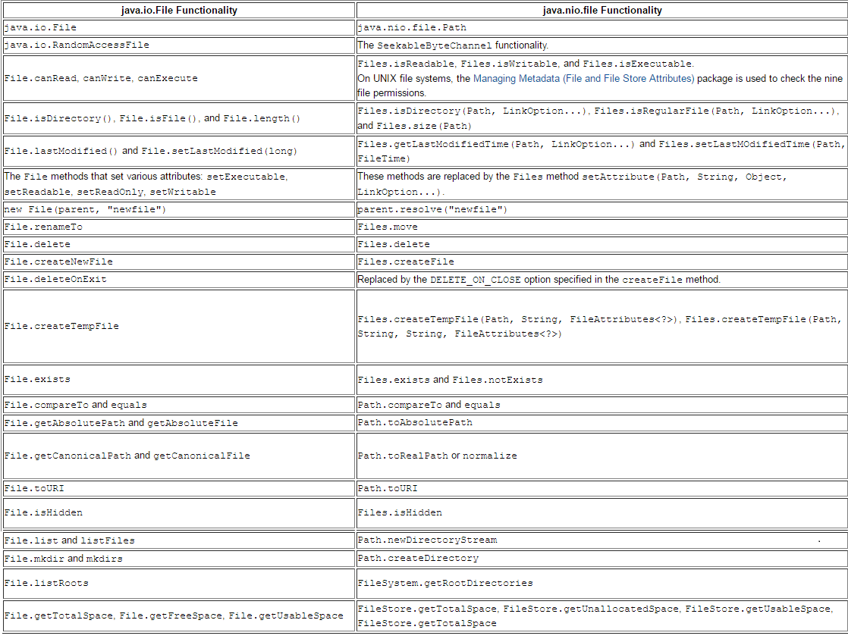

Slide 19
Agenda (cont.)
Java 8 Features
http://openjdk.java.net/projects/jdk8/features
forEach method implementation
Lambda Expressions
Bulk Data Operations For Collections by using Streams
Default and static methods in interfaces
Concurrency Updates
Parallel Array sorting mechanism
Java Date and Time API
Base64 Encoding & Decoding
Miscellaneous features

Slide 20

http://openjdk.java.net/projects/jdk8/features

Slide 21
forEach() method in Iterable interfaces
Whenever we need to traverse through a Collection, we need to create an Iterator whose whole purpose is to iterate over and then we have business logic in a loop for each of the elements in the Collection. We might get ConcurrentModificationException if iterator is not used properly.
Java 8 has introduced forEach() method in java.lang.Iterable interface so that while writing code we focus on business logic only. The new forEach() method takes java.util.function.Consumer object as argument, so it helps in having our business logic at a separate location that we can reuse.
Syntax : collectionObj.forEach( element -> System.out.println(element));

Slide 22
Lambda Expressions Closures and Functional Programming
Lamda Expressions provide anonymous function types to java
Replace use of anonymous inner class
Provide more functional style of programming in java
doSomething(new DoStuff(){
Public Boolean isGood(int value){
return value == 42;
}
}
);
Simplified to
doSomething( value -> value == 42 ) ;

Slide 23
Bulk Data Operations For Collections Filter, Map, Reduce for Java
Java.util.function package
- Function, Predicate, Consumer, Suplier interfaces
Java.util.stream package
- Stream, Collector, etc interfaces
Serial and parallel implementations
- Generally expressed with Lambda Expressions
Parallel implementations builds on Fork-join Framework
Lazy evaluation
- Things like findFirst() terminate stream

Slide 24
Method Implementation in interface
default methods in interface
Default methods enable you to add new functionality to the interfaces of your libraries and ensure binary compatibility with code written for older versions of those interfaces.
Four rules of default methods
You may get what is in the base interface
You may override a default method
If the method is there in the class hierarchy then it takes precedence
If there is no method on any of the classes in the hierarchy, but two of your interfaces that you implements has the default method
for this use rule 3.
Static Methods in interfaces
Java interface static method is similar to default method except that we can’t override them in the implementation classes. This feature helps us in avoiding undesired results incase of poor implementation in implementation classes.

Slide 25
Concurrency Updates
Scalable update variables
DoubleAccumulator, DoubleAdder, etc
Multiple variables avoid update contention
Good for frequent updates, infrequent reads
ConcurrentHashMap updates
- Improved scanning support, key computation
ForkJoinPool improvements
Completion based for IO bound applications
Thread that is blocked hands work to thread that is running

Slide 26
Parellel Array Sorting
Additionally utility methods in java.util.Arrays
- parallelSort ( multiple signatures for different primitives )
Anticipated minimum improvement of 30% over sequential sort
- For dual core system with appropriate sized data set
Built on top of the fork – join framework
- ParallelArray implementation

Slide 27

Java.util.Date API
Several problems here:
1. Which 12 is for which date field?
2. Month 12 is December, right? No. January
3. Year 12 is 12 CE, right? Wrong. 1913
4. Wait - there is a time in a date?
5. More than that, there is a time zone

Slide 28
Drawbacks
Conceptually an instant, not a date
Properties have random offsets
Some zero-based, like month and hours
Some one-based, like day of the month
Year has an offset of 1900
Mutable, not thread-safe
Not Internationalizable
Millisecond granularity
Does not reflect UTC

Slide 29
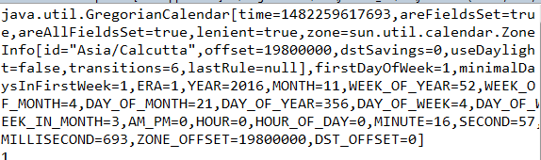
Java.util.Calendar API
Date was the work of James Gosling and Arthur van Hoff
Added in JDK 1.0, mostly deprecated in JDK 1.1, never removed
IBM donated Calendar code to Sun
System.out.println(new GregorianCalendar());

Slide 30
Java.util.Calendar API
System.out.println(dtFmt.format(new
GregorianCalendar(12, 12, 12).getTime()));
//
Several problems here:
1. Which 12 is for which date field?
2. Month 12 is December, right? No. January
3. They got the year right! Almost. 13 CE
4. Wait - there is a time in a calendar?
5. More than that, there is a time zone

Slide 31
Not Much Improvement
Conceptually an instant, not a calendar
But, can’t create a Calendar from a Date
Can’t format a Calendar
Zero-based offsets
Stores internal state in two different ways
milliseconds from epoch
set of fields
Has bugs and performance issues
Mutable, not thread-safe

Slide 32
JAVA 8 Date and Time API
2002 - Stephen Colebourne starts open source Joda-Time project
2005 - Release of Joda-Time 1.0
2007 - JSR 310, for inclusion in Java
2011 - Release of Joda-Time 2.0
2014 - Finally, the date and time API is in Java 8

Slide 33
No Problem Getting a Date
System.out.println(LocalDate.of(12, 12, 12));
// 0012-12-12
No problems:
1. ISO 8601 order of fields - year, month, day.
2. Month 12 is December.
3. Year is 12 CE.
4. No time component.
5. No time zone

Slide 34
New Packages
java.time - instants, durations, dates, times, time zones, periods
LocalDate, LocalTime, LocalDateTime
java.time.format - formatting and parsing
DateTimeFormatter
java.time.temporal - field, unit, or adjustment access to temporals
Temporal, TemporalAdjuster, TemporalAccssor, etc.
java.time.zone – support for time zones
ZoneRules, ZoneOffsetTRansition, etc.
java.time.chrono - calendar systems other than ISO-8601
ISO8601 (default): IsoChronology
Chinese : MinguoChronology
Japanese : JapaneseChronology
Thai Buddhist : ThaiBuddhistChronology
Islamic : HijrahChronology

Slide 35
Base64 Encoding and Decoding
Currently developers are forced to use non- public APIs
sun.misc.BASE64Encoder
Sun.misc.BASE64Decoder
Java SE 8 now has a standard way
- java.util.Base64.Encoder
- java.util.Base64.Decoder
- encode, encodeToString, decode, wrap methods

Slide 36
Miscellanious Features
String joining
Static and default methods
sorting implementation
Grouping operations
Combining Predicates and Functions
Map’s Convenience functions
Parallelizing Streams

Slide 37


Slide 38
Thank you

